Slide 1
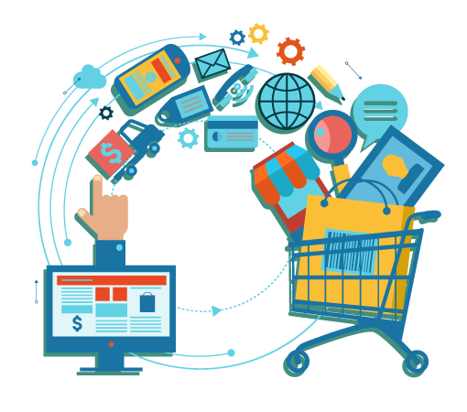
E-COMMERCE
Presented By: “Group c”
:Saurav chaulagain
:Sumit Manandhar
:Sumit Shahukhal
:Srijal Maharjan
:Songhang limbu

Slide 2
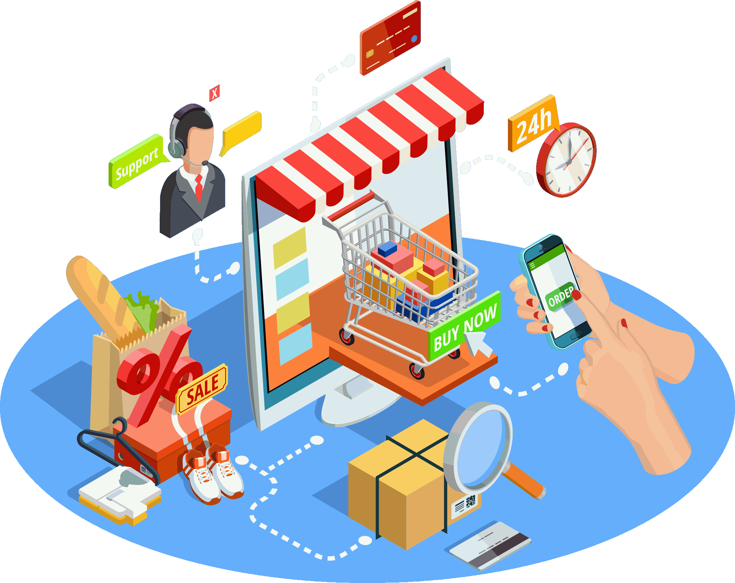
INTRODUCTION:
E-commerce is the activity of buying or selling of products
electronically over the internet.
It can also be described by any kind of commercial transaction facilized
through out the internet.
Whenever you buy or sell something using internet, you are involved in Ecommerce.
E-commerce include mobile commerce, electronic fund transfer, supply chain management, internet marketing, online transaction processing inventory management systems, and automated data collection systems.
Nearly every products are available through e-commerce transactions.

Slide 3

IS E-COMMERCE A GOOD SOURCE OF REVENUE?
Yes looking at the e-market of the world, e-commerce is a good source of revenue. E-commerce has become as the favorite business option for all. One of its big reason is the of high revenue generation, which is far better than other business and requires less investment. To make millions online, you just have to invest less than the multiple revenue streams available out in the market.
So I think e-commerce is a good source of revenue for all.

Slide 4
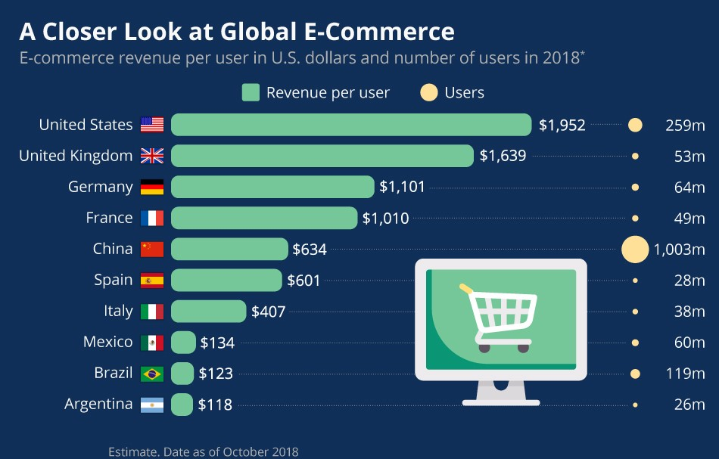
Global Chart of Revenue Generation on some countries in
the world.

Slide 5





Most popular E-commerce company in the world

Slide 6



Popular E-commerce company in Nepal.

Slide 7
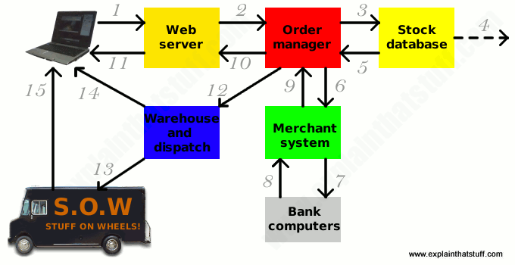
Working
E-commerce is all about combining a Web server that manages an online storefront, a database system to keep a check of the items in stock and a dispatch system link to a ware house where goods can be instantly located and sent to the buyer. E-commerce activities such as selling online can be directed at consumers or other businesses.

Slide 8
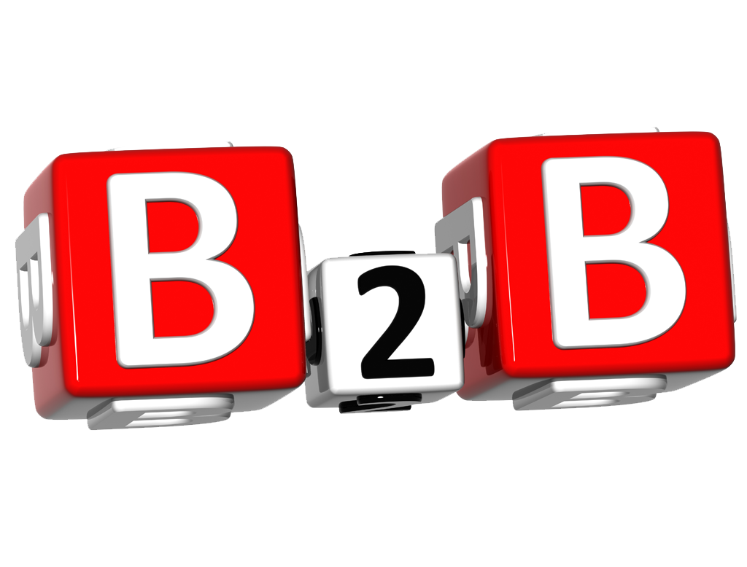
B2B (business to business)
Types:
B2B refers to commerce between two businesses rather than to commerce between a business and an individual consumer.
Decision making may take days, weeks or even months.
Decision are often made by a community.
It is buying or selling in whole sale.

Slide 9
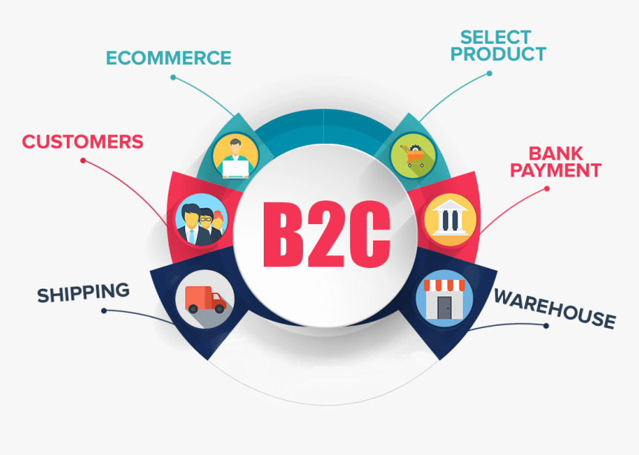
B2C ( business-to-consumer)
B2C refers to the commercial transaction between a business and end consumer.
It describe transaction between online retailer and several customers.
Purchasing decision is made by costumer so it take few time.
Usually B2C e-commerce web provide access to any visitors.

Slide 10
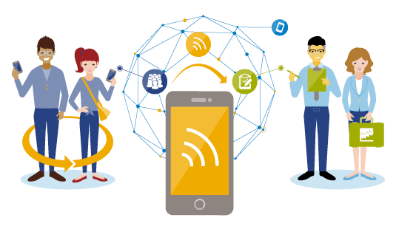
C2C (consumer-to-consumer)
C2C e-commerce web provide platform for customer to trade with another customers.
these sites allow customers to trade, buy, and sell items in exchange for a small commission paid to the site.
vendors sell their products on the site and buyers purchase what they want.
It is also effortless and handy and does not take much time to use.

Slide 11
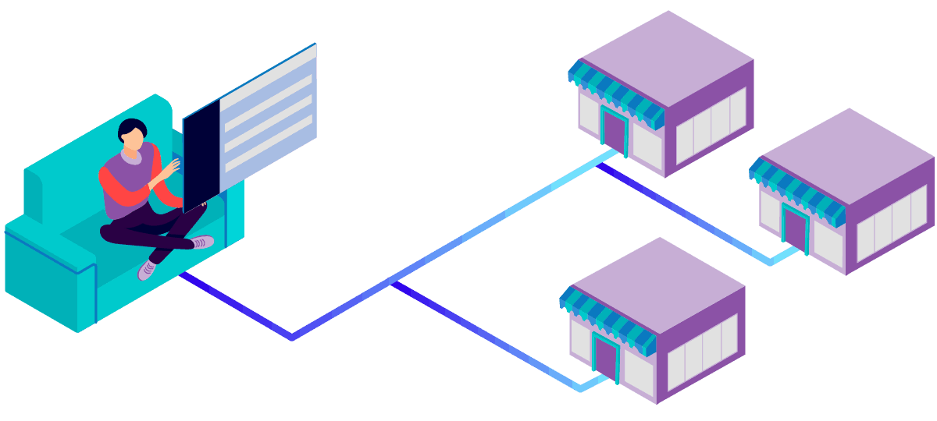
C2B(consumer to business)
This online commerce business is when the consumer sells goods or services to businesses.

Slide 12

Advantages of E-commerce
Buying and selling is faster as well finding products is really easy.
It is available 24/7.
Operation cost is low with better quality of services.
Physical set up for business is not necessary.
It is easy to start and manage business.
Customers can easily select products from different providers without moving around physically.

Slide 13

Disadvantages of e-commerce
There is no guarantee of product quality.
The buyer cannot check or try the products until purchase.
Hackers can get information of yours and lead to spamming and other threats.
One cannot buy or sell when the site is crashed.

Slide 14


